Slide 1
Amplifying Organisational Intelligence
AI Solutions in Medicine
9th March 2019
Notes:
Thanks everyone for attending in this presentation.
I am Amin Khatami from Intellify. Intellify is an AI-based industrial consultancy in Australia, which has capacity and capability for doing AI/Data Science projects here.
This talk covers some of my experience of my joint collaborations with medical imaging labs and hospitals in both Canada and China. There is an opportunity here in Intellify to explore this experience in Medical domain.
Let’s introduce myself a bit.

Slide 2
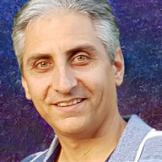
Amin Khatami
Senior Data Scientist
Honorary Affiliate at Deakin University
15+ years of Data Science and Mathematical Modelling
https://www.linkedin.com/in/amin-khatami/
PhD in Deep Learning, Computer Vision
B@Msc in Applied Mathematics, Stochastic Optimisation
PhD thesis: Deep Neural Network Generalisation in Medical Applications
Msc thesis: Neural Network Evalutionary Based Solutions for Dynamic Stochastic Optimisation: New Approach
Notes:
I am currently a senior data scientist in Intellify.
My academic affiliation is with Deakin University, working at Monash university and, in addition, having15 years experience working in industry, specialized in AI and ML solutions.
My PhD is in Deep Learning, majoring at medical imaging.
OK

Slide 3
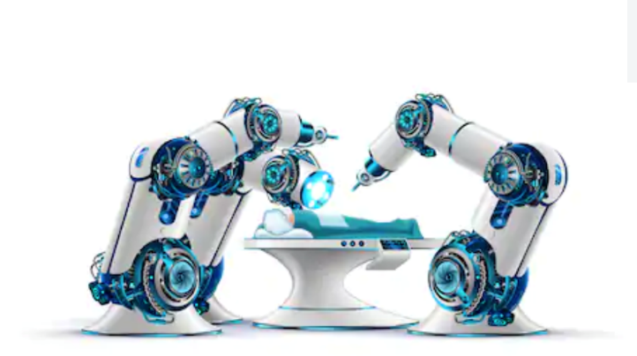
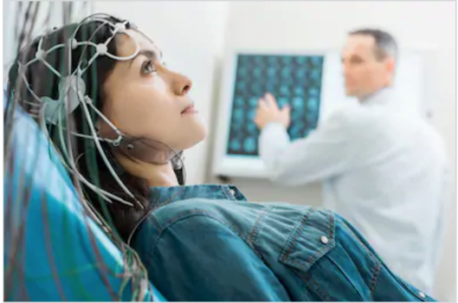
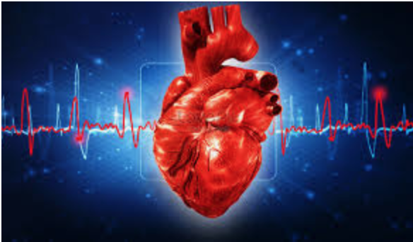
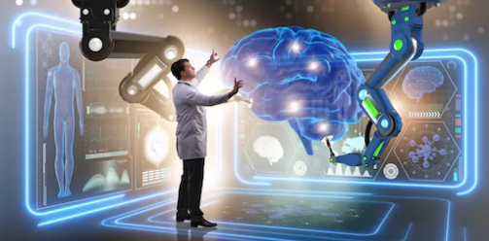
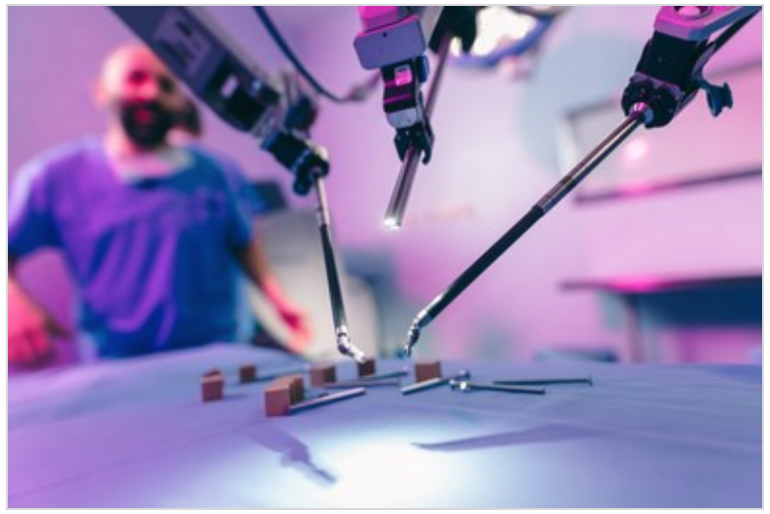
AI & Robotics in Medical Practices
Medical Imagery
Robotic surgery
Biomedical Applications
Medical Imaging
Disease Recognition
Discover Anomalous Patterns
Content-based Medical Image Retrieval
Signal Processing
Medical Haptics Feedbacks
Surgical Robots and Tactile Understanding
Signal Processing
Electroencephalogram (EEG)
Genomic Medicine
Notes:
Let’s start with the AI and robotic related experience I’ve achieved since last 5 years.
Starting with a question: In your idea, What are the most common ML use cases in Medical world?
Do you agree diagnosis in Medical Imaging, Drug Discovery, and also Robotic Surgery are some of the most common use cases at the moment?
How about future applications? Do you agree Personalized Medicine, Automatic Treatment or Recommendation, and Autonomous Robotic Surgery are some of the most use cases in the future?
I believe, the answer is somehow YES.
Do you know why those use cases are the most common, or what features make these use cases so common? Computer Vision, Deep Learning, Bigdata, and big data infrastructure.
So, based on this, I chose some of my works, which I am going to highlight here.
Medical imaging and Discovery Anomalous Patterns (Anomaly Detection) in large digital pathology images. Segmentation, Classification, Retrieval Information, and diagnosis are just some of applications. In the next couple of slides, I am going to explain a content-based image retrieval algorithm, which I developed in a medical imaging lab.
The second is some related works in surgical robotic. I successfully could developed two different systems which enable a robot to recognize a sense and a few second future prediction.
The third which I cannot cover today is signal processing and EEG. As, I believe most of you guys know analyzing brain reaction in specific situation. I do not think so I can have time to talk more on this.

Slide 4

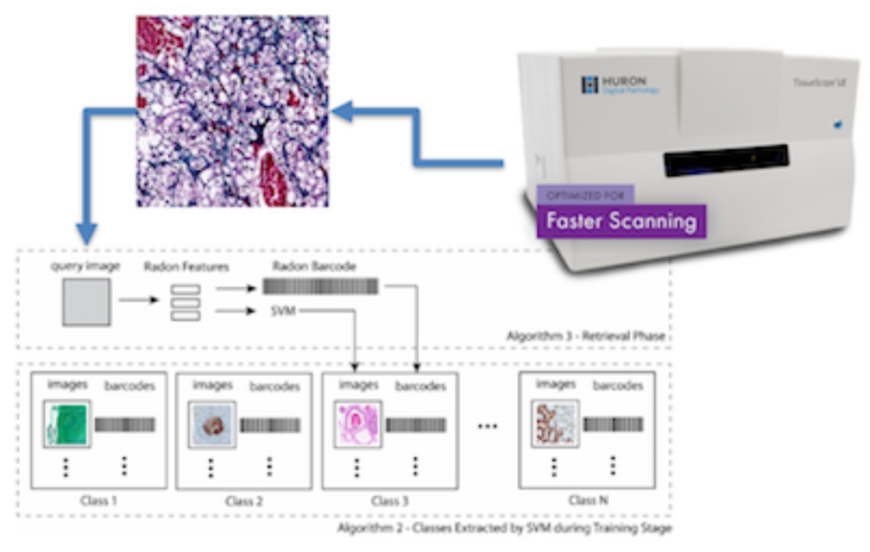
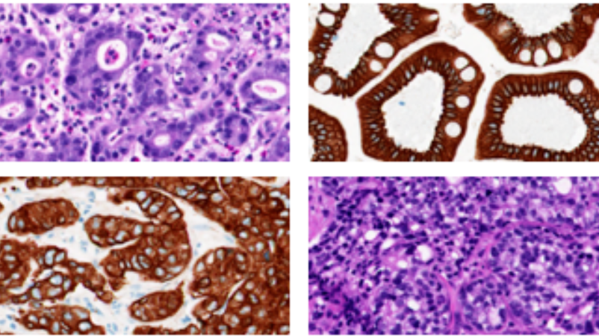
Automatic classification systems & X-ray Image Retrieval
Challenges:
Biomedical and healthcare in general "suffering" from BigData.
Labelled Data is another challenge
Thousands and thousands of specimens in large physical archives
Need to be converted to digital pathology
Solutions:
Digital format opens new horizons for diagnosis in medicine by Capturing the tissue characteristics in digital formats
This will be a relief for many hospitals with limited space.
Many solutions based on classification, segmentation, and retrieval
Acquiring an image from the specimen enables more systematic analysis, collaborations possibilities and, last but not least, the computer-aided diagnosis for pathology, arguable the final frontier of vision-based disease diagnosis.
Health care Atlas automation
Notes:
As I mentioned, some of the works I did, have been developed in a medical imaging lab called KIMIA.
The KIMIA lab has funded by government in Canada. The guys in this lab are developing AI-based industrial techniques, using hospital data, specially from US.
I delivered several computer-aided diagnosis frameworks there. This work is one of the joint work I have with them.
Generally speaking, what we are looking for first is aiming at a transition from traditional medical data, for example pathology, to digital one, for example pathology.
These technologies enable us to look inside the human body for diagnosis, treatment and monitoring purposes.
But, in general, there are some challenges here.
Medical domain is suffering from Bigdata. Very difficult to have millions images in medicine now, but how about in future?
Lack of huge Labelled medical data is another challenge. When I am talking about labeled data, it means which image is benign or malignant.
Concern of recording huge samples and physical images.
Concern of how to convert to digital specimens
There are several solutions for this:
When we convert them to digital, this format opens new horizons for diagnosis in medicine by Capturing the tissue characteristics in digital formats. This definitely will be a relief for many hospitals with limited space.
These Captured information is proposing solutions based on classification, segmentation, retrieval, and so on.
Acquiring an image from a sample. For example, if you have a new sample, it does not matter it is an image or a text, what is the most similar sample which has been already diagnosed. This enables more systematic analysis and so on.
Let’s talk about a computer-aided system, we’ve developed before.

Slide 5
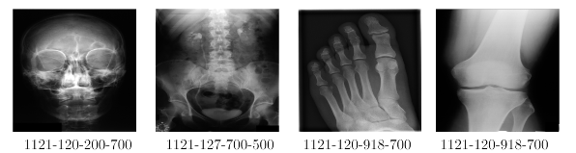
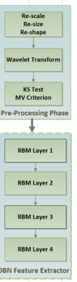
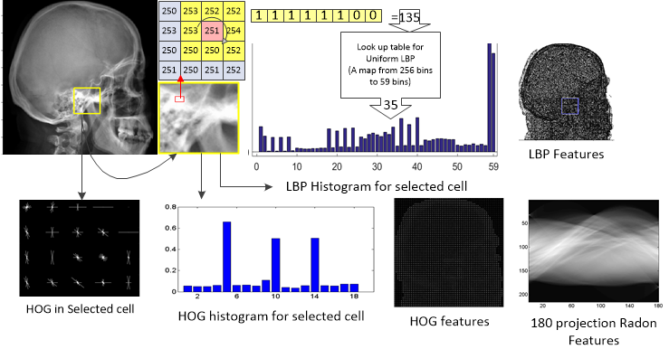
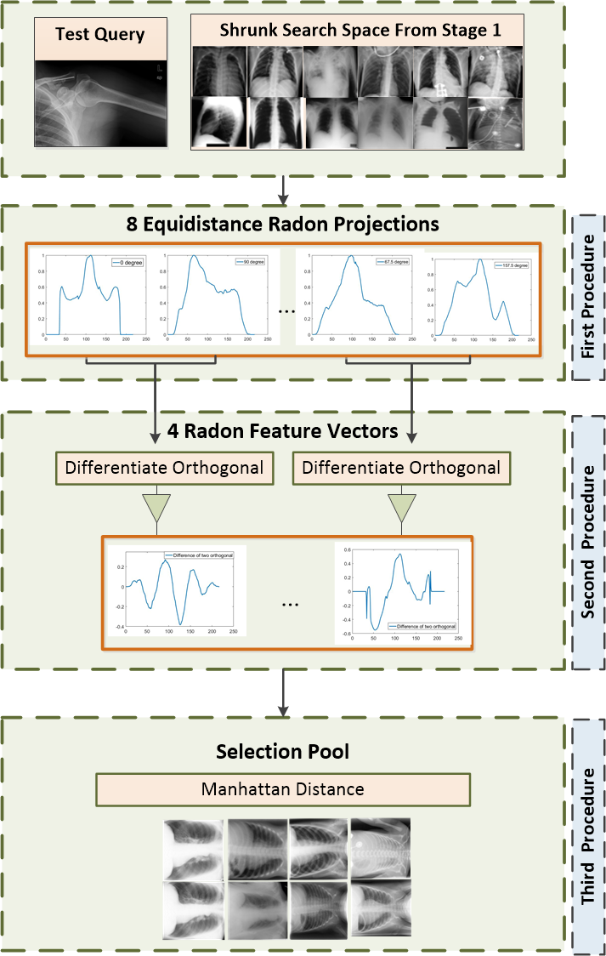
Automatic classification systems & X-ray Image Retrieval
Our Approaches, computer-aided diagnosis techniques
Unsupervised and Supervised Techniques
Combination of Deep Learning and traditional ML
Content-Based Image Retrieval and BARCODE
Binary Tags for Big Image Data
Notes:
This work has been done in KIMIA lab.
Just to clarify, since we weren’t allowed to publish their hospital data, by their agreement, we chose a part of our developed algorithm, and then the technique was evaluated on a public dataset.
These technologies enable us to look inside the human body for diagnosis, treatment and monitoring purposes.
Our approach was to develop a computer-aid diagnosis technique to retrieve images based on barcodes, tags, or text strings. For example, if you look at the top radiology pictures, there are some related codes. What I developed was first using deep learning and transform learning to capture information from images, then, using traditional similarity search-based techniques such as Radon, HOG, and LBP to find the top 3 most similar images.
Capturing the tissue characteristics in digital formats opens new horizons for diagnosis in medicine.

Slide 6
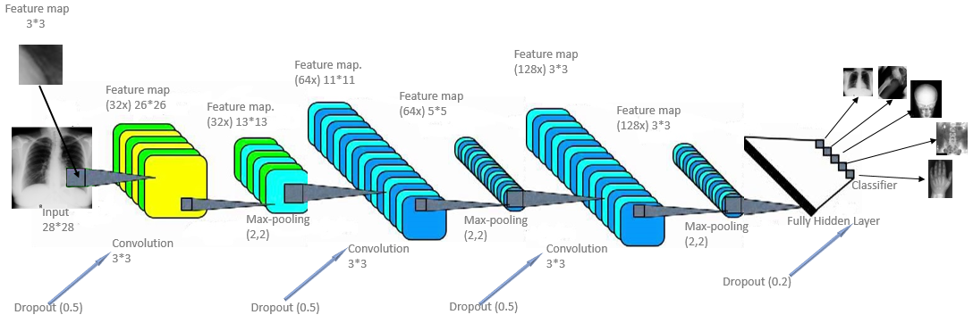
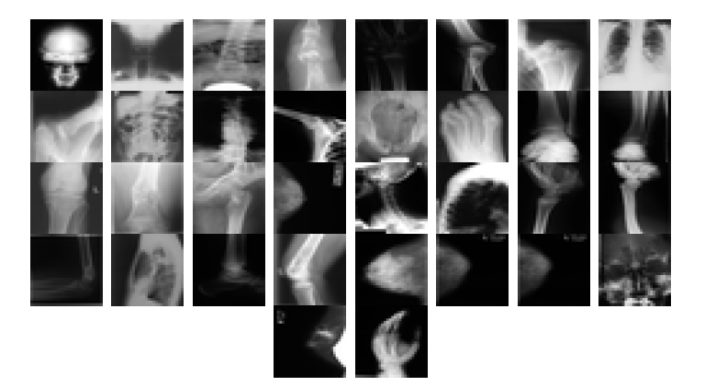
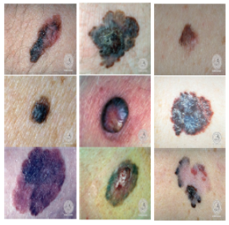
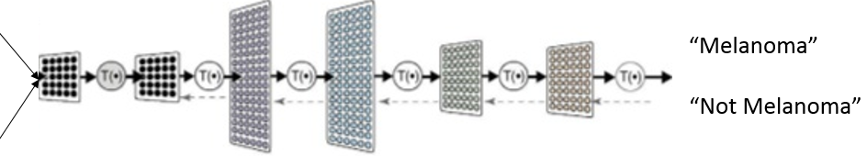
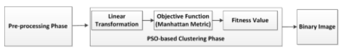
Automatic classification systems – Colour Features & Contents
Convolutional Neural Network
Classification
Colour-shape based foreground object detection
Classification and Segmentation​
Colour Space to segment ROI detection
Notes:
Images classification as well as cancer diagnosis are other developed techniques from myside which are needed to highlight.
Convolutional Neural Networks are used to develop these frameworks.
As for colour space, I used evolutionary methods to define a linear formulation to segment the region of interest part.

Slide 7
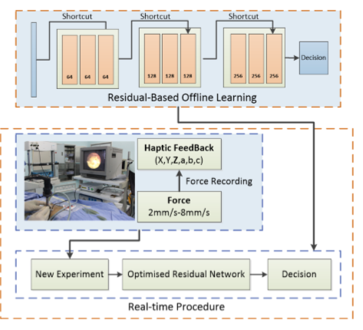
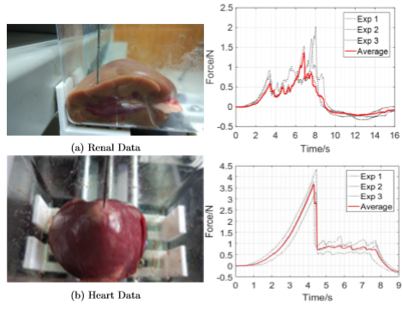
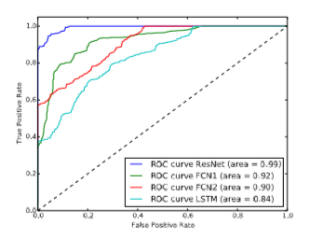
Surgical Robot and Haptics
A Deep Learning-Based Model For Tactile Understanding on Haptic Data Percutaneous Needle Treatment
Tactile understanding during surgery is essential in medical simulation.
The importance is emphasised when problems such as a delay is occurring during simulation.
Monitoring, predicting, and understanding the sense of tissue which is supposed to be involved in operation is vital during surgery
Notes:
Surgical robot is another application to talk here.
To improve a remote surgical operation one step further, I developed a sequence classiﬁcation technique, categorizing diﬀerent tissues, evaluating on biomechanics data.
The aim of this project was that we want to go one step further for autonomous perspective. So, it is a recommendation system for the specialist doing surgery using haptics.
Actually, from the signals (we called force feedback in Haptics) we are receiving remotely, the proposed system predicting the organ involves plus the force feedback is supposing to receive in some steps after.
The future work of this project is to combine these signals with visual information, by equipping the devices by cameras. Hope to see these very soon.

Slide 8
References & Publications
A. Khatami, A. Khosravi, T. Nguyen, C.P. Lim, S.Nahavandi, ”Data Analysis Using Wavelet Transform and Deep Belief Networks”, Journal of Expert System with Applications, 190-198, 2017, Elsevier.
A. Khatami, A. Khosravi, S. Nahavandi, H.R. Tizhoosh, ”Parallel Deep Solutions for Data Retrieval from Imbalanced Archives”, Journal of Applied Soft Computing, 2017, Elsevier
A. Khatami, M. Babaei, H.R. Tizhoosh, A. Khosravi, S. Nahavandi, ”A Sequential Search-Space Shrinking Using CNN Transfer Learning and a Radon Projection Pool for Data Retrieval”, Journal of Expert System with Application, 2018
A. Khatami, M. Babaei, H.R. Tizhoosh, A. Khosravi, S. Nahavandi, ”A Radon-Based Convolutional Neural Network for Medical Image Retrieval ”, International Journal of Engineering, 2018.
M. Babaie, A. Khatami, Sh. Rahnamayan, Classiﬁcation and Retrieval of Digital Pathology Scans: A New Dataset, CVPR, 2017.
A. Khatami, A. Khosravi, H.R. Tizhoosh, S. Nahavandi, A deep-structural Image Classiﬁcation for a Radon-based Data Retrieval, IEEE CCECE, 2017, IEEE.
A. Khatami, Y. Tai, A. Khosravi, L. Wei, S. Nahavandi, A Deep-Based Model For Tactile Understanding on Data Percutaneous Needle Treatment, ICONIP, 2017.
A. Khatami, S. Mirghasemi, A. Khosravi, C.P. Lim, S. Nahavandi, A Swarm Optimization-based Kmedoids Clustering Technique for Extracting Colour Features from Melanoma Skin Cancer Images, ICONIP, 2017
A. Khatami, Y. Tai, A. Khosravi, L. Wei, S. Nahavandi, A Haptics Feedback Based-LSTM Predictive Model for Pericardiocentesis Therapy, ICONIP, 2017.

